Slide 1
Fatalities Resulting from Police Encounters
Megan Crawford

Slide 2
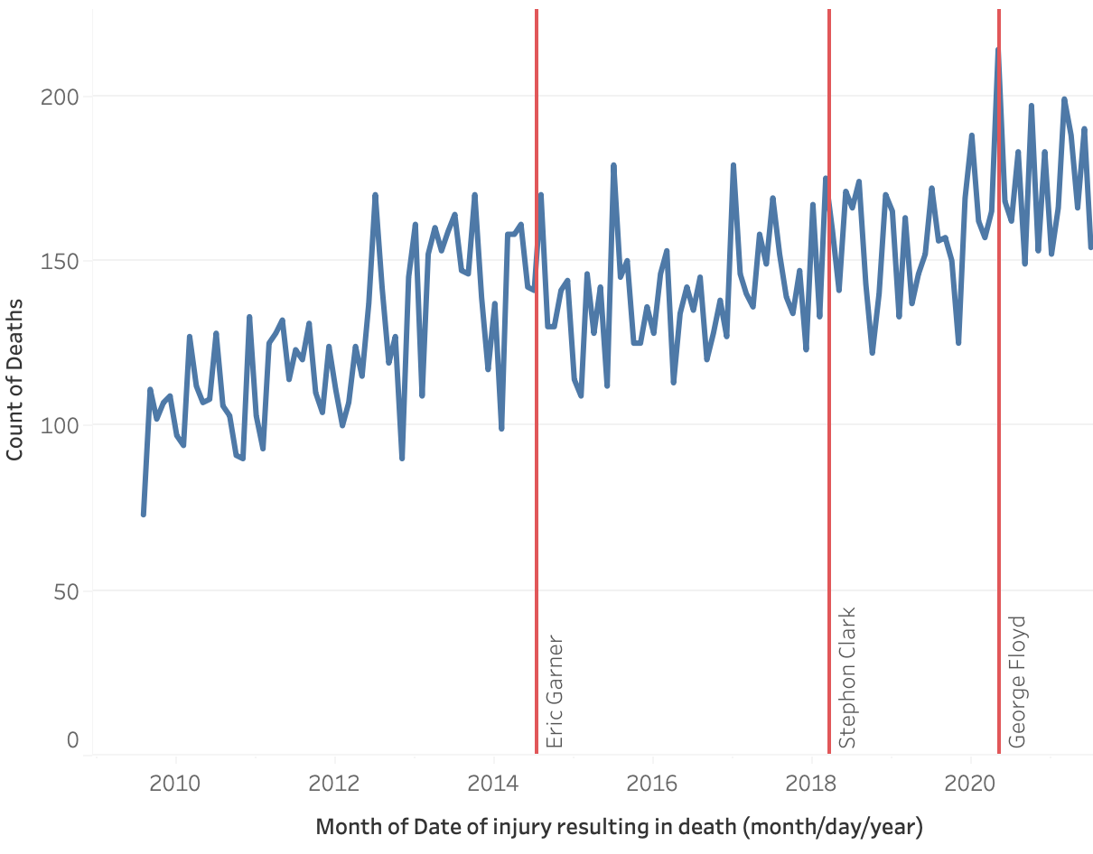
Immediate Drop In Deaths Following High-Profile Incidents but Lack of Long-Term Change
Sharp drop in deaths in month after high-profile incident that garners national media attention
Short-term changes in thought and action due to pressure from the public
When the attention fades, fatalities resulting from police encounters continue to steadily rise again
Long-term trend is steady increase in deaths
Immediate fixes to appease the media and people are not effective; need to invest more in long-term solutions such as adapting training programs or increasing background checks on incoming officers
Takeaway: The Department of Justice must invest more in long-term solutions to address the root causes of police brutality rather than implementing ineffective quick fixes when the media attention wears out.

Slide 3
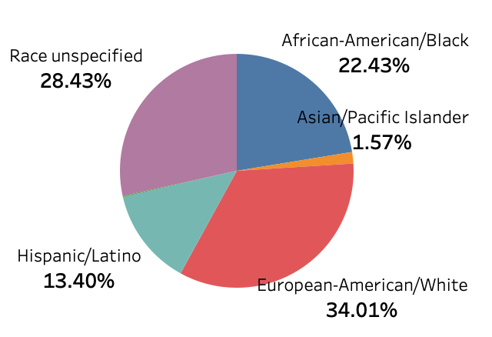
Racial Breakdown of Fatality Victims
African-Americans represent 22% of victims whose race is specified, but only 14% of the US population
White people make up 34% of the victims whose race is specified but make up 75% of the US
This discrepancy shows that there is an issue with racial bias in the police force
Takeaway: The Department of Justice should educate police officers on implicit bias and implement training to counteract racial bias in the field.

